Slide 1
1st OpenSlice Hackfest (Tutorial) Design 5GaaS Specification
Kostis Trantzas | TSC Chair
University of Patras, GREECE

Slide 2
Login to OpenSlice

Slide 3
Hackfest OpenSlice Portal
Navigate to https://osl.p-net.gr/
Click on the Services tab or Services Portal button
Click on Sign In
Username: hackfestuserX
Password: osl_hack_X
Welcome to the administrator’s (Service Designer) view of the Services Portal

Slide 4
Design the UPF Resource Facing Service Specification (RFSS)

Slide 5
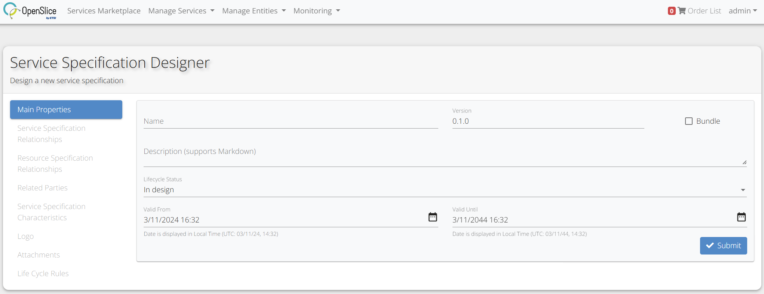
UPF RFSS Design
Create a Service Specification for deploying UPF
Navigate to the Manage Services tab > Service Specifications > New Service Specification

Slide 6
UPF RFSS Design
Populate UPF Service Specification with user information
Provide the Name field and click Submit
upf_{account_username}, e.g. upf_hackfestuser1

Slide 7
UPF RFSS Design
Declare that UPF Service Specification will use ArgoCD Application for deployment
Navigate to Resource Specification Relationships tab
Assign Application@argoproj.io/v1alpha1@pnet-k8s-cluster@https://10.1.6.65:6443/
Observe the change to ResourceFacingServiceSpecification (top left)

Slide 8
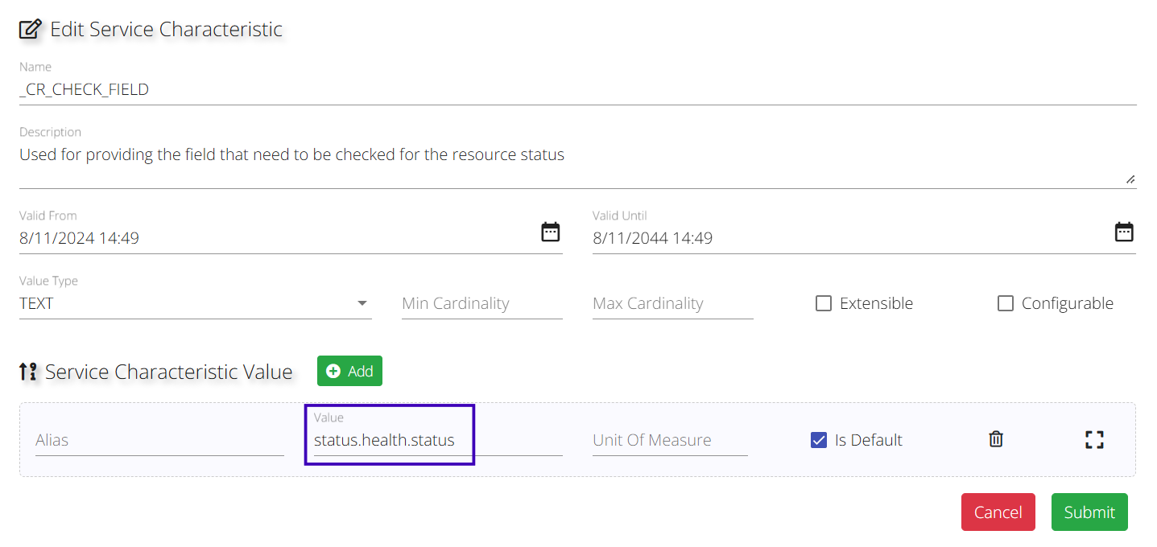
UPF RFSS Design
Map the lifecycle of ArgoCD Application (e.g., Progressing, Healthy) to TMF Resource State (e.g. reserved, active)
Navigate to Service Specification Characteristics tab
Edit the characteristics below:
_CR_CHECK_FIELD (Value = status.health.status)
_CR_CHECKVAL_AVAILABLE (Value = Healthy)
_CR_CHECKVAL_RESERVED (Value = Progressing)
_CR_CHECKVAL_STANDBY (Value = Progressing)
_CR_CHECKVAL_UNKNOWN (Value = Missing)

Slide 9
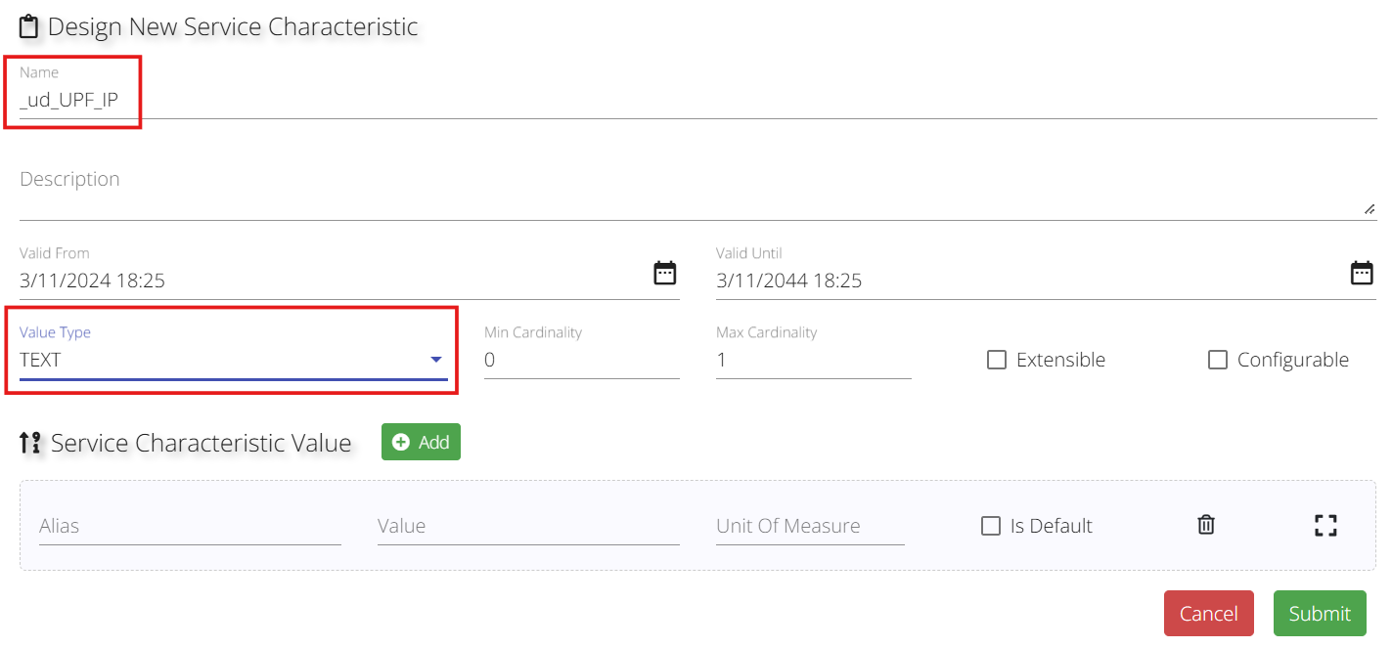
UPF RFSS Design
Create a placeholder for UPF deployment IP
Remain at Service Specification Characteristics tab
Create new characteristic
Name = _ud_UPF_IP
Value Type = TEXT
Validate that it appears in the Characteristics list

Slide 10
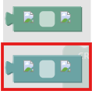
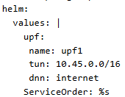
UPF RFSS Design
Provide the template that ArgoCD will use to deploy UPF (LCM rule 1)
Open the upf_template.yaml
Provide unique identity for each deployment with LCM rules
Navigate to Life Cycle Rules tab > Create new rule
Define Lifecycle Phase as “PRE_PROVISION”
Service > Text > Set characteristic value of “_CR_SPEC” block
Text > Formatted text block - attached to previous block
Text > Multi-line text block - attached to Input (String) connector of previous block
Paste the content of upf_template.yaml into the last block
Change
spec.destination.namespace from CHANGE_ME to %s
spec.source.helm.values.ServiceOrder from CHANGE_ME to %s

Slide 11
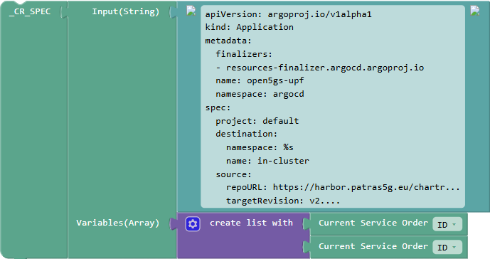
UPF RFSS Design
Lists > Create list with block – attached to Variables (Array) connector of Formatted text block
Click the gear of the List block and remove an item
Create variables blocks – attached to the List block
Service > Context > Get Service Order details block
Service > Context > Get Service Order details block
Click “Save”

Slide 12
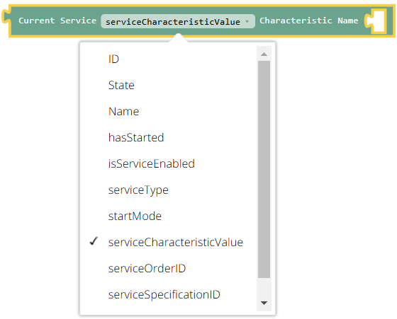
UPF RFSS Design
Populate the UPF deployment IP placeholder, after the Service is active (LCM rule 2)
Navigate to Life Cycle Rules tab > Create new rule
Define Lifecycle Phase as “AFTER_ACTIVATION”
Service > Text > Set characteristic value of “_ud_UPF_IP” block
Operations > Generic > Extract a value from a JSON block – attached to previous block
Service > Characteristics > Compute Variable block – attached to json (text) connector of previous block
Service > Context > Get Service details block – attached to previous block
Text > Line of text block – fill it with the expected characteristic name, i.e. Service.upf1.json
Text > Line of text block – fill it with the expected JSON Path, i.e. status.loadBalancer.ingress[0].ip – attached to JsonPath (Text) connector of the extract value from JSON block
$.status.loadBalancer.ingress[0].ip
Service.upf1.json

Slide 13
Design the 5G Core Resource Facing Service Specification (RFSS)

Slide 14
5G Core RFSS Design
Create a Service Specification for deploying the remaining 5G Core
Navigate to the Manage Services tab > Service Specifications > New Service Specification
Populate 5G Core Service Specification with user information
Provide the Name field and click Submit
core_{account_username}, e.g. core_hackfestuser1
Declare that 5G Core Service Specification will use ArgoCD Application for deployment
Navigate to Resource Specification Relationships tab
Assign Application@argoproj.io/v1alpha1@pnet-k8s-cluster@https://10.1.6.65:6443/
Observe the change to ResourceFacingServiceSpecification (top left)

Slide 15
5G Core RFSS Design
Map the lifecycle of ArgoCD Application (e.g., Progressing, Healthy) to TMF Resource State (e.g. reserved, active)
Navigate to Service Specification Characteristics tab
Edit the characteristics below:
_CR_CHECK_FIELD (Value = status.health.status)
_CR_CHECKVAL_AVAILABLE (Value = Healthy)
_CR_CHECKVAL_RESERVED (Value = Progressing)
_CR_CHECKVAL_STANDBY (Value = Progressing)
_CR_CHECKVAL_UNKNOWN (Value = Missing)

Slide 16
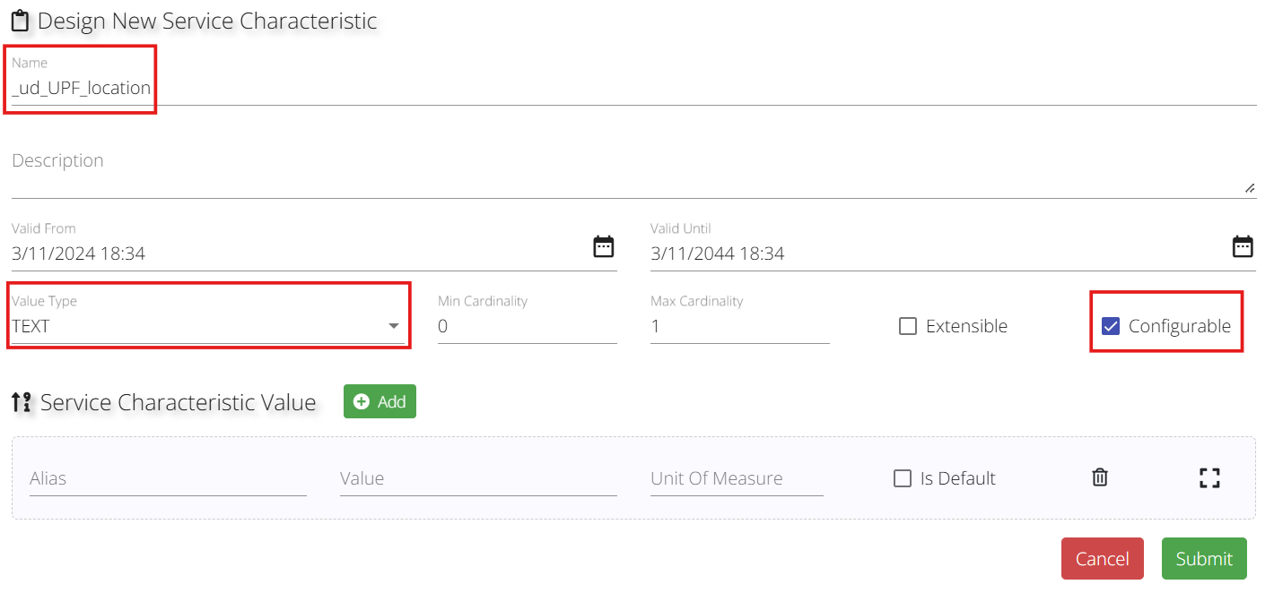
5G Core RFSS Design
Create a placeholder for the UPF location (known after the UPF is deployed)
Remain at Service Specification Characteristics tab
Create new characteristic
Name = _ud_UPF_location
Value Type = TEXT
Configurable = true
Validate that it appears in the Characteristics list

Slide 17
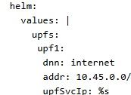
5G Core RFSS Design
Provide the template that ArgoCD will use to deploy the remaining 5G Core (LCM rule)
Open the core_template.yaml
Provide unique identity for each deployment with LCM rules
Navigate to Life Cycle Rules tab > Create new rule
Define Lifecycle Phase as “PRE_PROVISION”
Service > Text > Set characteristic value of “_CR_SPEC” block
Text > Formatted text block - attached to previous block
Text > Multi-line text block - attached to Input (String) connector of previous block
Paste the content of core_template.yaml into the last block
Change
spec.destination.namespace from CHANGE_ME to %s
spec.source.helm.values.upfs.upf1.upfSvcIp from CHANGE_ME to %s
spec.source.helm.values.ServiceOrder from CHANGE_ME to %s

Slide 18
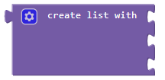
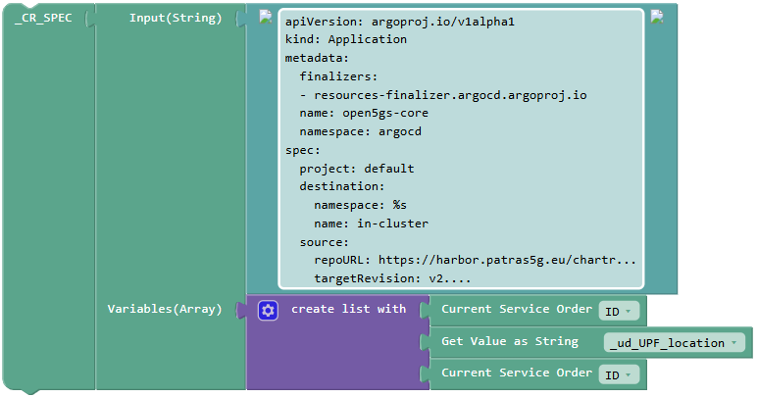
5G Core RFSS Design
Lists > Create list with block – attached to Variables (Array) connector of Formatted text block
Create variables blocks – attached to the List block
Service > Context > Get Service Order details block
Service > Characteristics > Get Value as String block – find _ud_UPF_location
Service > Context > Get Service Order details block

Slide 19
Design the 5GaaS Customer Facing Service Specification (CFSS)

Slide 20
5GaaS CFSS Design
Create a Service Specification that will be exposed to the customer, including the previous RFSSs
Navigate to the Manage Services tab > Service Specifications > New Service Specification
Populate 5GaaS Service Specification with user information
Provide the Name field 5G Connectivity ({account_username}), e.g. 5G Connectivity (hackfestuser1)
Click Bundle checkbox
Click Submit button

Slide 21
5GaaS CFSS Design
Include the UPF & 5G Core RFSS into the service bundle
Navigate to Service Specification Relationships tab
Assign UPF RFSS (e.g., upf_hackfestuser1) and 5G Core RFSS (e.g., core_hackfestuser1) to the bundle
Observe the Relationships Overview graph at Main Properties tab

Slide 22
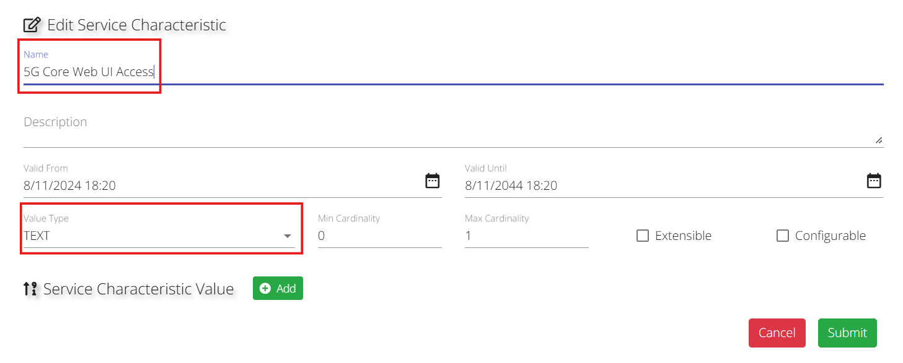
5GaaS CFSS Design
Create a placeholder for the 5G Core web UI access
Navigate to Service Specification Characteristics tab
Create new characteristic
Name = 5G Core Web UI Access
Value Type = TEXT
Validate that it appears in the Characteristics list

Slide 23
5GaaS CFSS Design
Provide the service execution dependency (LCM rule 1)
By default, all Service Specifications in a bundle are executed in parallel
At this scenario we would like:
Deploy UPF first
Acquire UPF’s deployment IP
Provide UPF’s deployment IP and deploy the rest of the 5G Core
Navigate to Life Cycle Rules tab > Create new rule

Slide 24
5GaaS CFSS Design
Define Lifecycle Phase as “CREATION”
Text > Create String variable block – click on the Rename variable… and rename it as UPF_IP
Service > Relationships > Service Refs > Get Service Details (upf_hackfestuser1) block – changed to serviceCharacteristicValue of _ud_UPF_IP (written within a Text > Line of text block)
Service > Relationships > Service Refs > Create a service conditionally block
Create Ref Service connector
Service > Relationships > Service Refs > core_hackfestuser1 block
If connector
Logic > Not block, followed by Logic > is equal to (strings) block
Compare left – Text > Returns the value of a variable block – choose “UPF_IP” variable from the drop-down menu
Compare right – Text > Line of text block
Characteristics connector
Lists > Create list block (remove 2 extra items)
Service > Relationships > Service Refs > Set values to characteristics block
Name block – Text > Line of text block filled with _ud_UPF_location
Value block – Text > Returns the value of a variable block – choose “UPF_IP” variable from the drop-down menu

Slide 25
5GaaS CFSS Design
Extract the 5G Web UI access URL (LCM rule 2)
Navigate to Life Cycle Rules tab > Create new rule
Define Lifecycle Phase as “SUPERVISION”
Service > Text > Set characteristic value of “5G Core Web UI Access” block
Text > Create a piece of text block
Text > Line of text block filled with 150.140.195.200: – attached to the first connector
Operations > Generic > Extract a value from a JSON block – attached to the second connector
Service > Characteristics > Compute Variable block – attached to json (text) connector of previous block
Service > Relationships > Get Service details of upf_hackfestuser1 block – attached to previous block and changed to “serviceCharacteristicValue”
Text > Line of text block – fill it with the expected characteristic name, i.e. Service.open5gs-webui.json
Text > Line of text block – fill it with the expected JSON Path, i.e. $.spec.ports[0].nodePort – attached to JsonPath (Text) connector of the extract value from JSON block

Slide 26
Expose the 5GaaS CFSS

Slide 27
Exposure in a public Catalog
Navigate to Services Marketplace
All the hackfest-designed services will be exposed to the Service Catalog Explorer
Catalog > Hackfest category
This will be performed by the instructor, so as to avoid conflicts
Create category “Hackfest”
Assign the designed 5GaaS CFSSs
Assign the created category to a catalog

Slide 28
Order the 5GaaS CFSS

Slide 29
Browse and Order the 5GaaS CFSS
Navigate to Services Marketplace
From Catalog > Hackfest category select your designed CFSS
5G Connectivity ({account_username}), e.g. 5G Connectivity (hackfestuser1)
Click the preview button
Place in Order List
Note the Order List cart that is updated (top-right)
Click the Order List cart and preview the Order
Reduce the Requested Completion Date to match the hackfest’s duration
Fill it in by the instructor’s notes
Order Service

Slide 30
Preview the 5GaaS Order

Slide 31
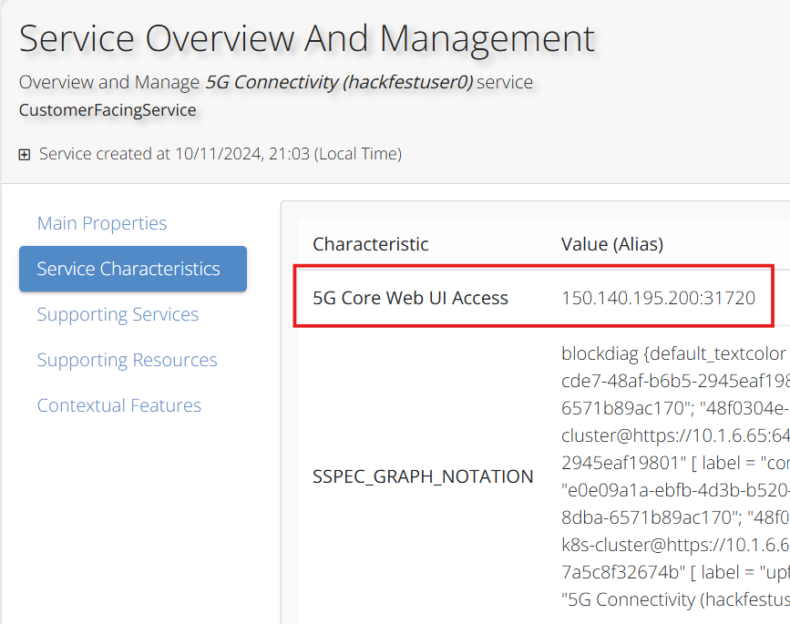
Preview the 5GaaS Order
Navigate to Manage Services tab > Service Orders (admin view) or My Service Orders tab (user view)
Click on the issued Service Order
Placed by your username, e.g. hackfestuser1
On the preview screen, click the edit button (when prompted by the instructor)
Change state from “INITIAL” to “ACKNOWLEDGED”
Click Submit
Switch to the Order Item #1

Slide 32
Q & A

Slide 33
Thank You!

